Slide 1





BANKRUPTCY PREVENTION PROJECT
STEPS TOWARDS PROJECT
Ms. Pallavi
Mr. Rajasekhar
MENTOR:-
Business Objective Understanding
Data importing
TEAM MEMBERS FROM (GROUP – 5)
Exploratory Data Analysis
Mr. KAKARAPARTHI MAHESH
Mrs. DIPALI VINAY PATIL
MISS. TEJASWINI ASHOKRAO AHER
Mr. SHUBHAM BALASAHEB BHOSALE
Ms .UJWALA SANJAY PAWAR
MS. AVANTI LAXMAN AVHAD
Mr. ANIL PARABATI JADHAV
Checking for the duplicates
Dropping the duplicates
Data balancing
Splitting data into x and y
Model building
deployment

Slide 2

Bankruptcy Prevention Project
Business Problem:
Business Companies goes bankrupt
Business Objective:
This is a classification project, since the variable to predict is binary (bankruptcy or non-bankruptcy).
The goal here is to model the probability that a business goes bankrupt from different features.

Slide 3

DETAILS : The data file contains 7 features about 250 companies including the following variables: >> industrial risk: 0=low risk, 0.5=medium risk, 1=high risk. >> management_risk: 0=low risk, 0.5=medium risk, 1=high risk. >> financial flexibility: 0=low flexibility, 0.5=medium flexibility, 1=high >> credibility: 0=low credibility, 0.5=medium credibility, 1=high credibility. >> competitiveness: 0=low competitiveness, 0.5=medium competitiveness, 1=high competitiveness. >> operating_risk: 0=low risk, 0.5=medium risk, 1=high risk. >> class: bankruptcy, non-bankruptcy (target variable).
Bankruptcy Prevention Project

Slide 4
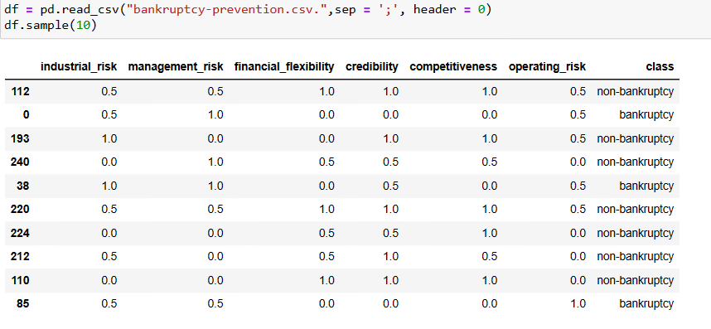
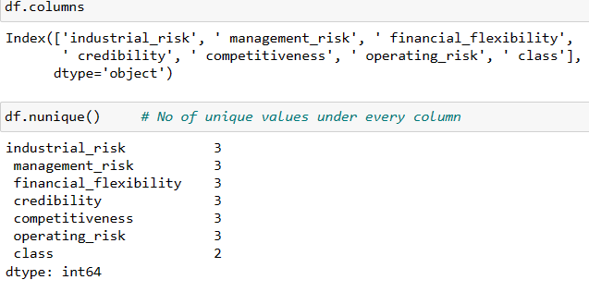
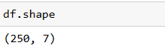
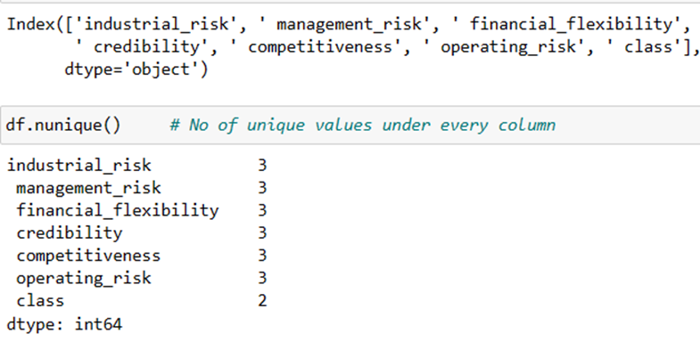
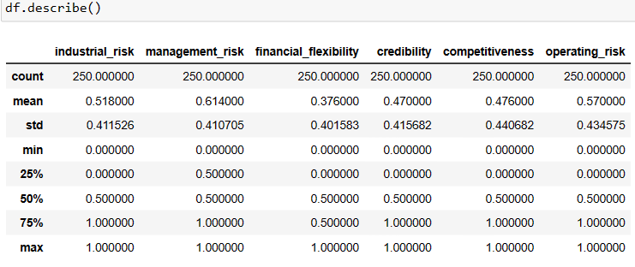
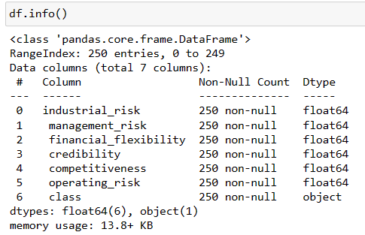
Bankruptcy Prevention Project
BASIC EXPLORATRY DATA ANALYSIS
IMPORTING DATA SET
COLUMN
SHAPE
NUMBER OF UNIQUE VALUES UNDER EVERY COLUNM
DESCRIBE
INFO

Slide 5
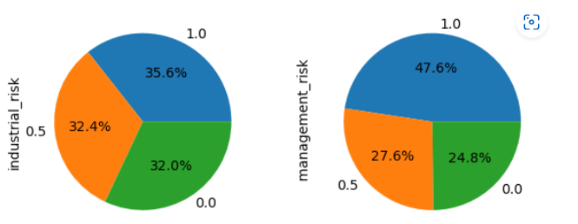
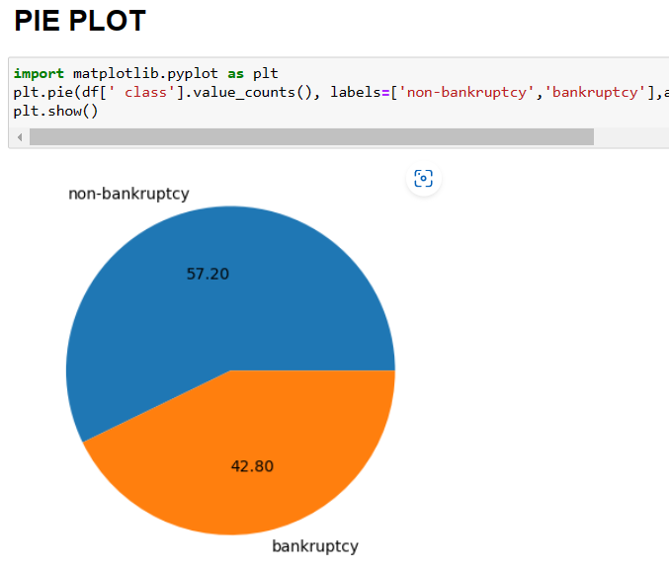
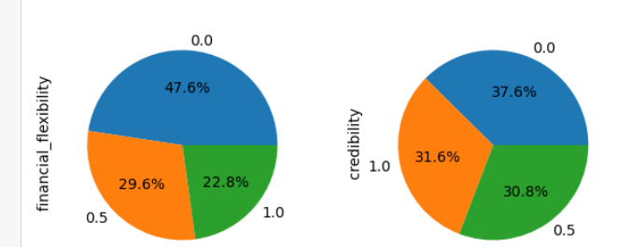
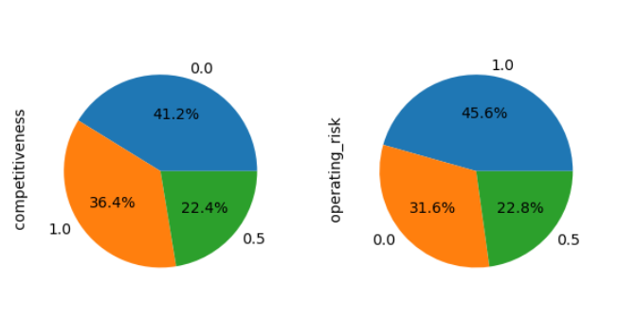
Bankruptcy Prevention Project
BASIC EXPLORATRY DATA ANALYSIS
PIE PLOTS

Slide 6
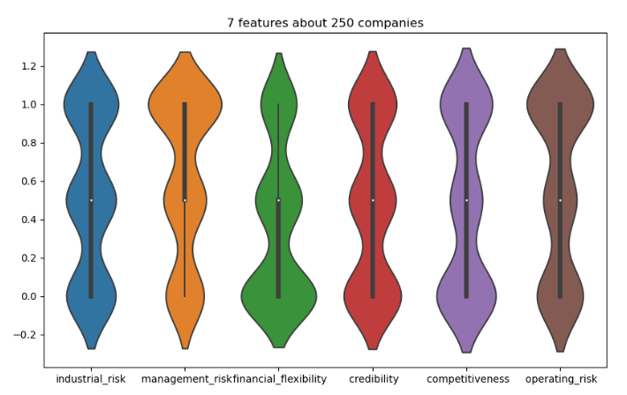
Bankruptcy Prevention Project
BASIC EXPLORATRY DATA ANALYSIS
VIOLIN PLOTS

Slide 7
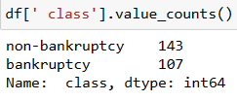
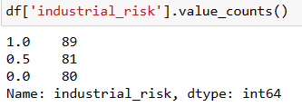
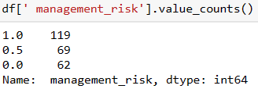
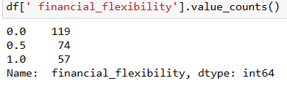
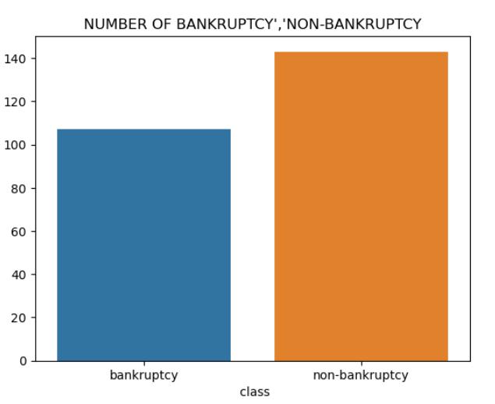
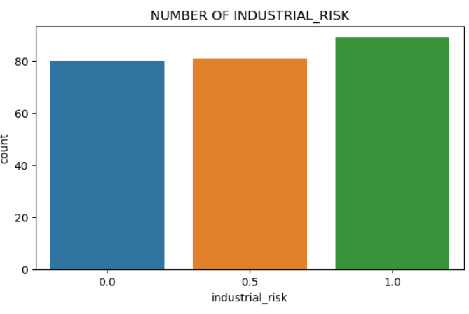
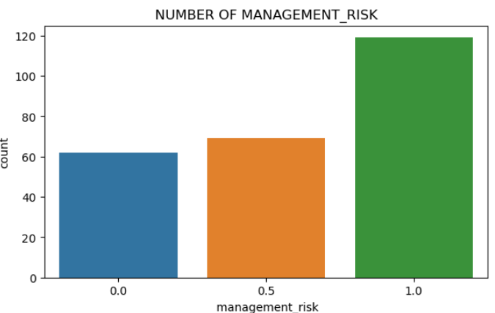
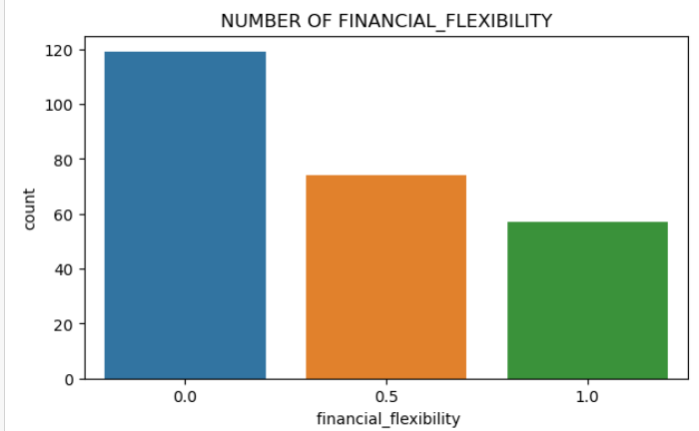
Bankruptcy Prevention Project
BASIC EXPLORATRY DATA ANALYSIS
COUNT PLOTS
CLASS
INDUSTRIAL_RISK
MANAGEMENT_RISK
FINANCIAL_FLEXIBILITY

Slide 8
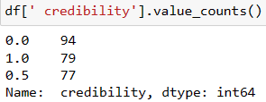
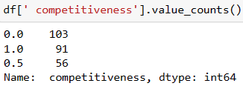
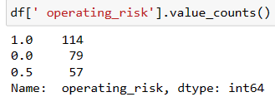
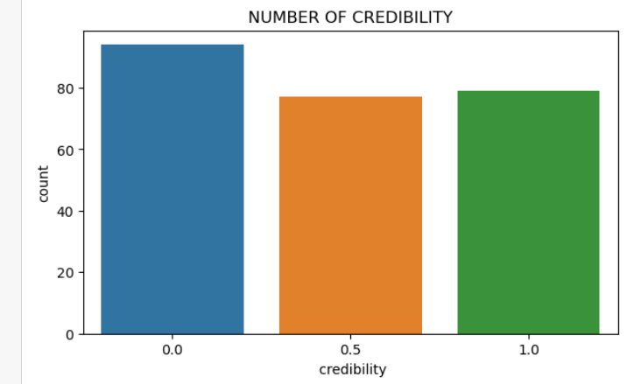
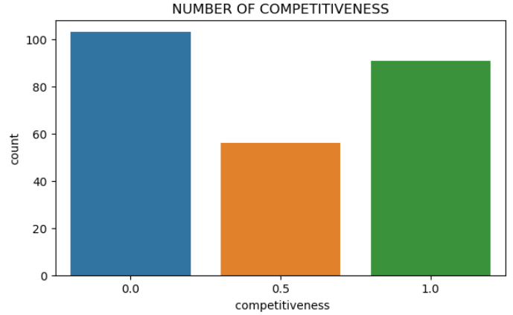
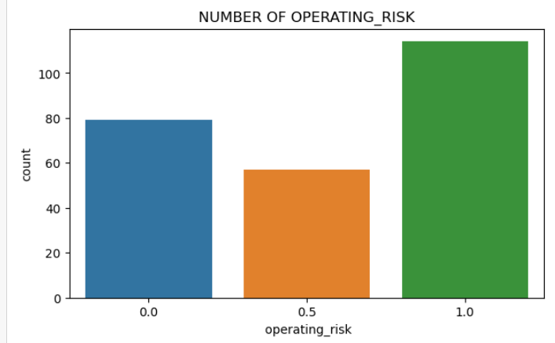
Bankruptcy Prevention Project
BASIC EXPLORATRY DATA ANALYSIS
COUNT PLOTS
CREDIBILITY
COMPETITIVENESS
OPERATING_RISK

Slide 9

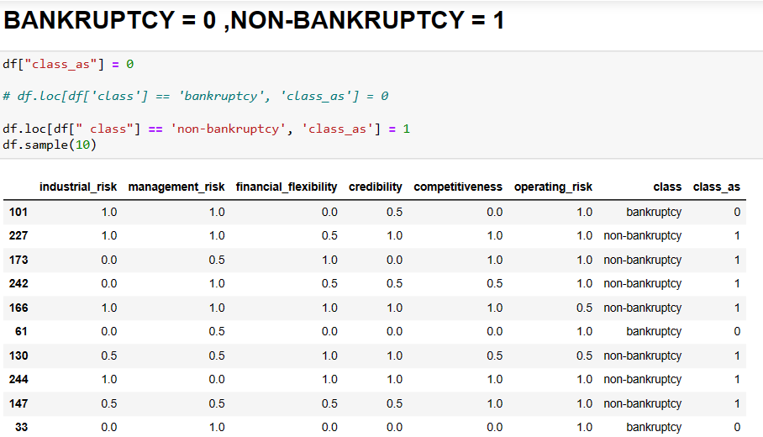
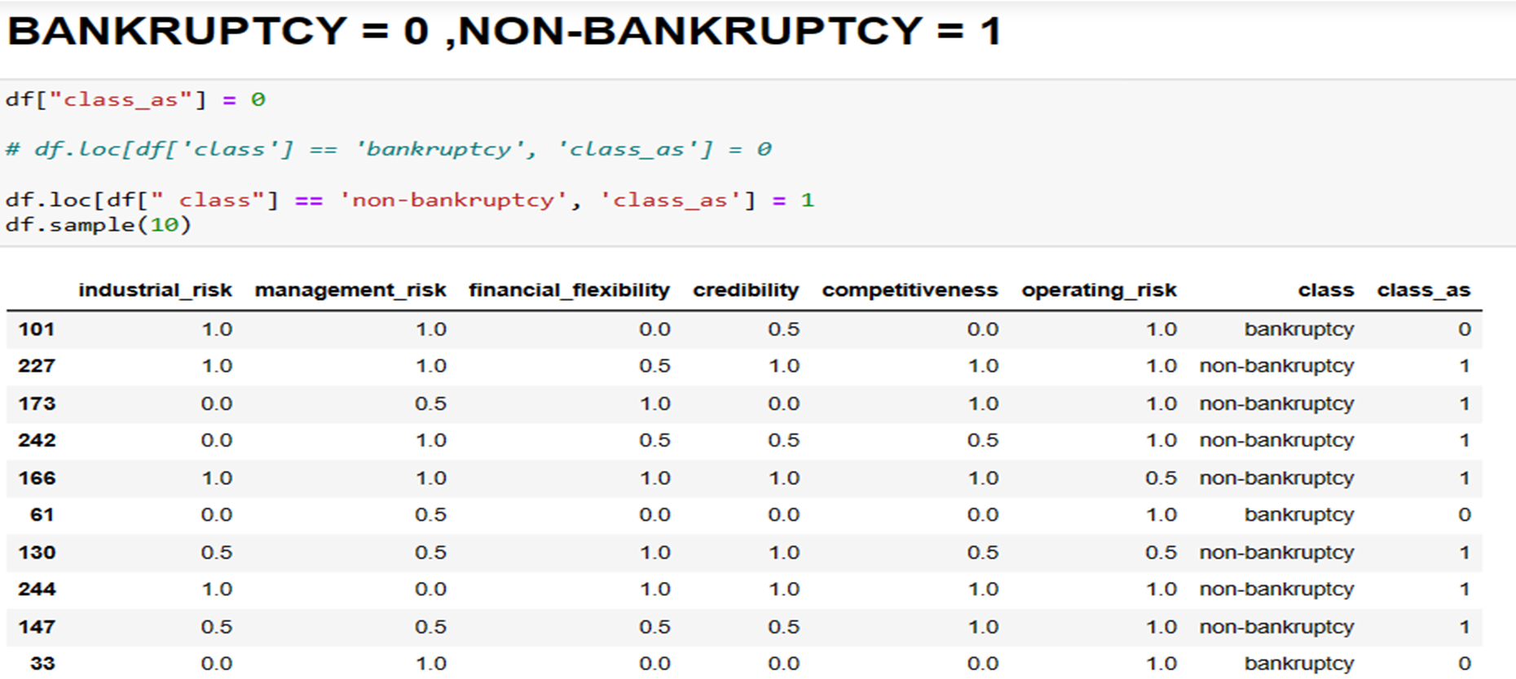
Bankruptcy Prevention Project
BASIC EXPLORATRY DATA ANALYSIS
I have added another variable and named as class_as then I asked

Slide 10
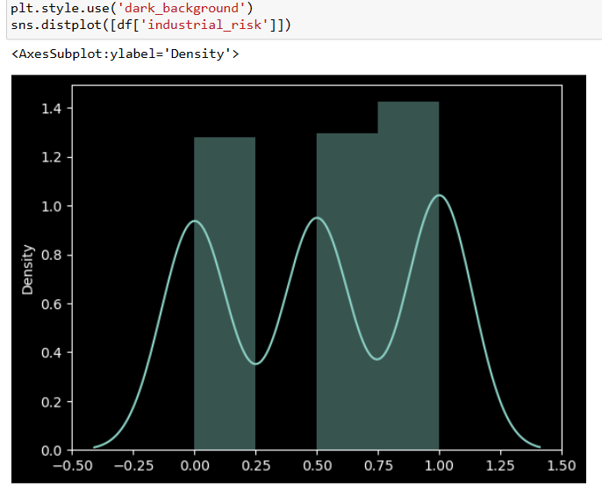
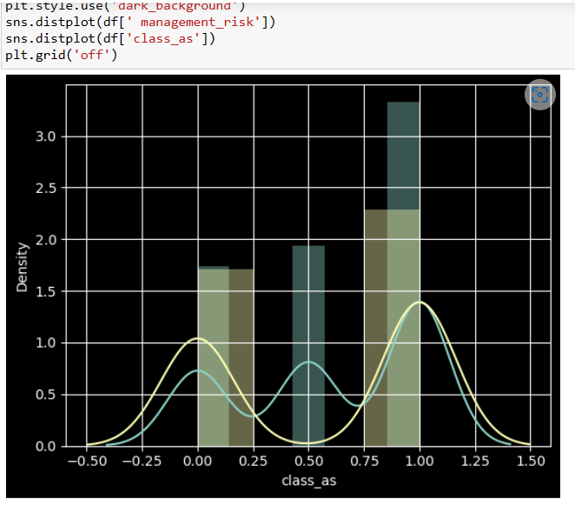
Bankruptcy Prevention Project
BASIC EXPLORATRY DATA ANALYSIS
DIST PLOTS
INDUSTRIAL_RISK
MANAGEMENT_RISK

Slide 11
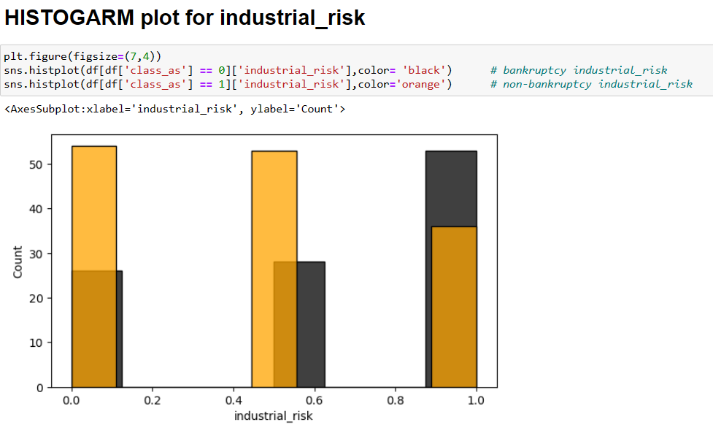
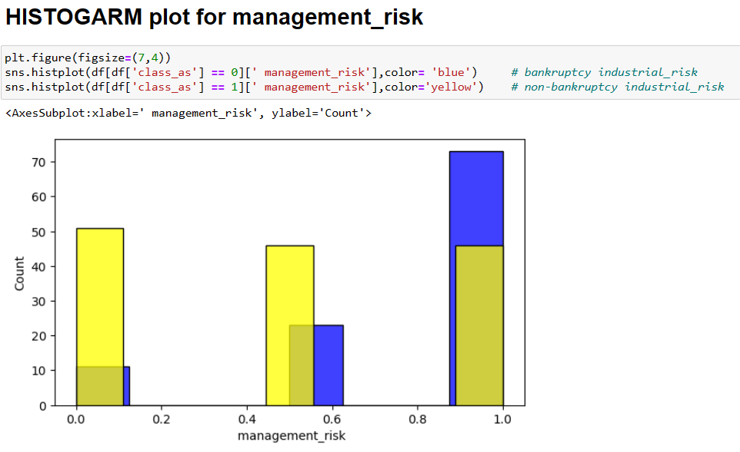
Bankruptcy Prevention Project
BASIC EXPLORATRY DATA ANALYSIS
HISTOGRAM PLOT FOR INDUSTRIAL_RISK
HISTOGRAM PLOT FOR MANAGEMENT_RISK
bankruptcy industrial_risk = BLACK
bankruptcy industrial_risk = BLUE
non-bankruptcy industrial_risk = ORANGE
non-bankruptcy industrial_risk = YELLOW

Slide 12
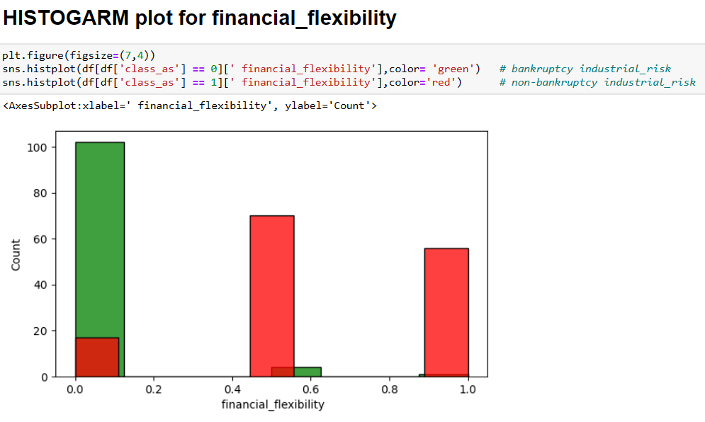
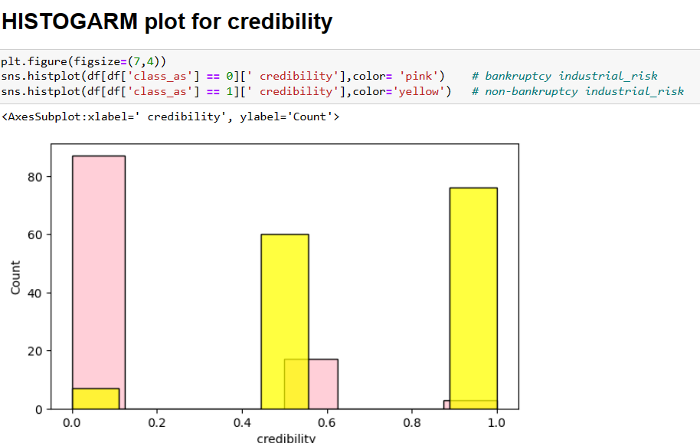
Bankruptcy Prevention Project
BASIC EXPLORATRY DATA ANALYSIS
HISTOGRAM PLOT FOR FINANCIAL_FLEXIBILITY
HISTOGRAM PLOT FOR CREDIBILITY
bankruptcy industrial_risk = GREEN
bankruptcy industrial_risk = PINK
non-bankruptcy industrial_risk = RED
non-bankruptcy industrial_risk = YELLOW

Slide 13
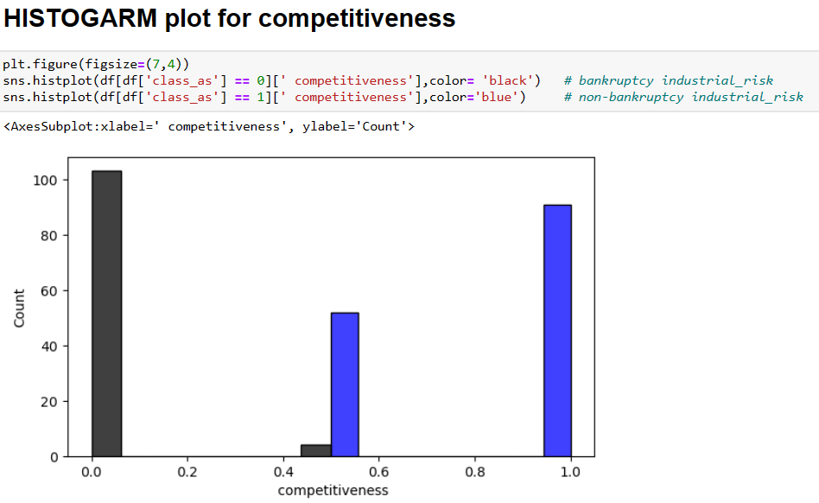
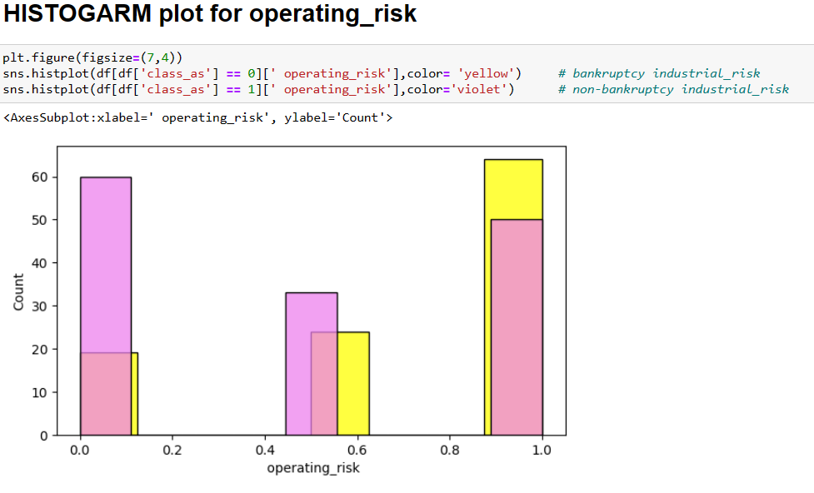
Bankruptcy Prevention Project
BASIC EXPLORATRY DATA ANALYSIS
HISTOGRAM PLOT FOR COMPETITIVENESS
HISTOGRAM PLOT FOR OPERATING_RISK
bankruptcy industrial_risk = BLACK
bankruptcy industrial_risk = YELLOW
non-bankruptcy industrial_risk = BLUE
non-bankruptcy industrial_risk = VIOLITE

Slide 14
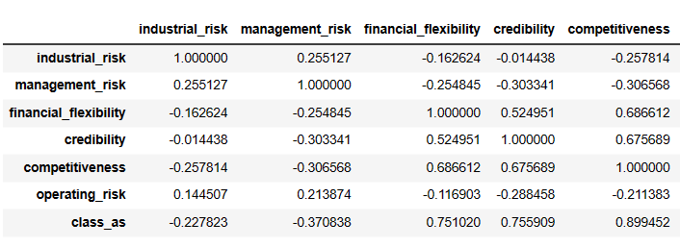
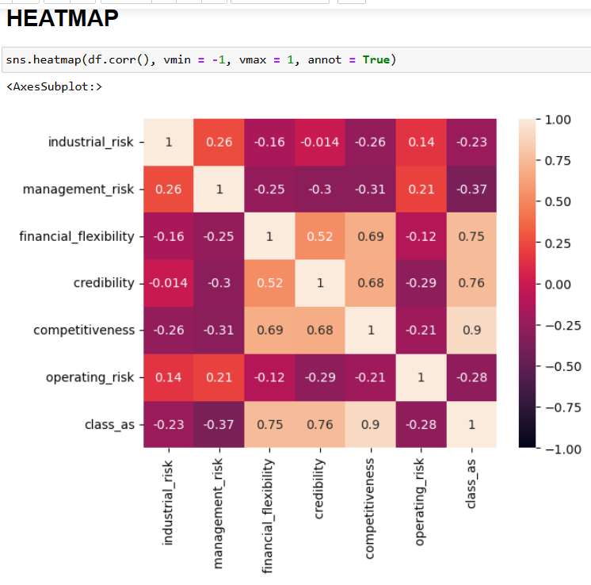
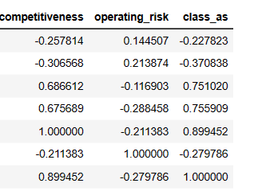
Bankruptcy Prevention Project
BASIC EXPLORATRY DATA ANALYSIS
CORELATION
HEATMAP

Slide 15
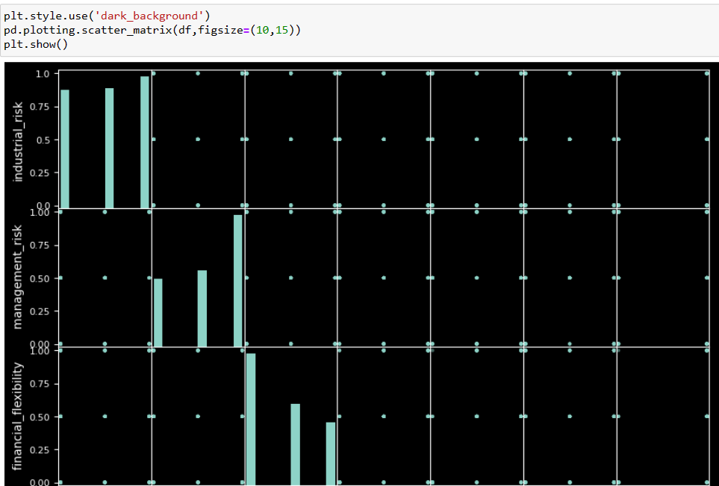
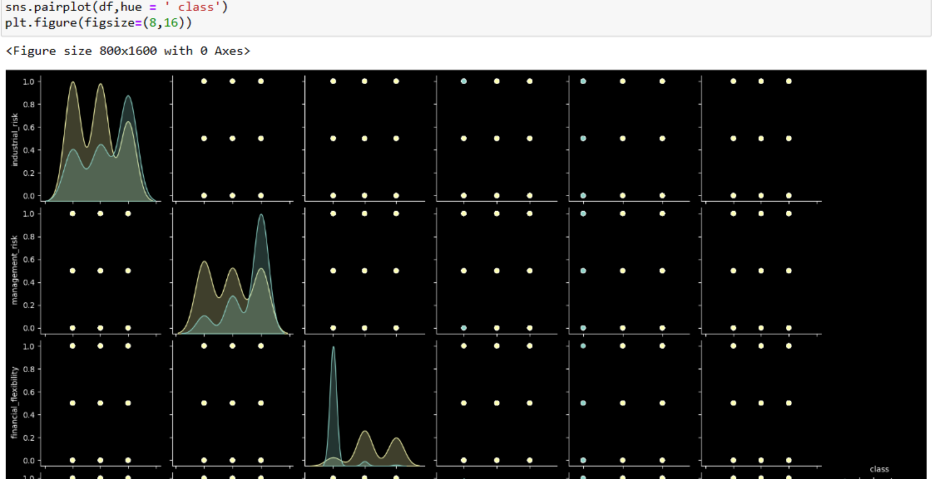
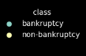
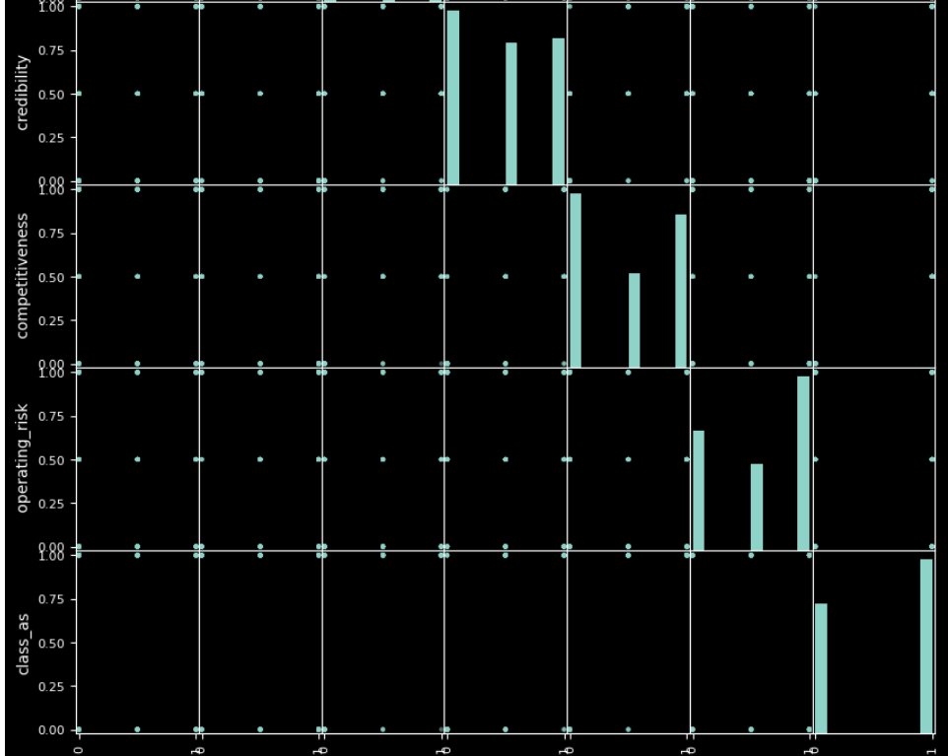
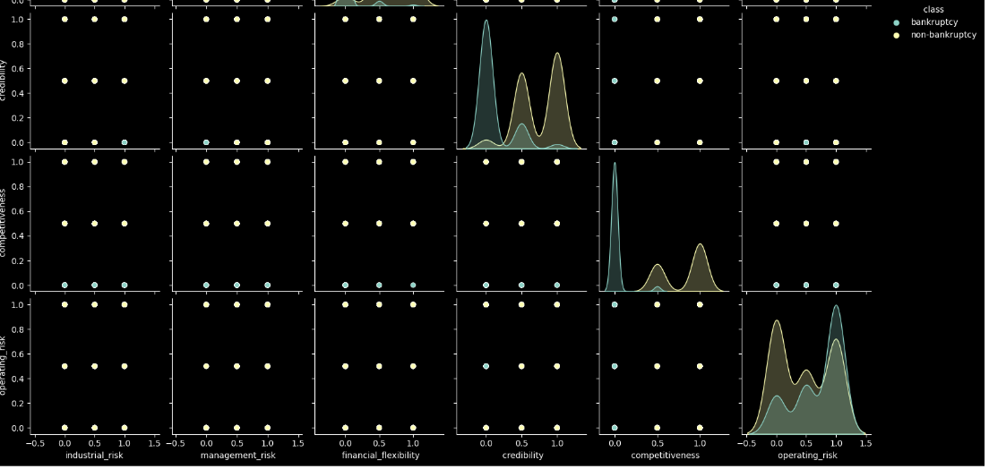
Bankruptcy Prevention Project
BASIC EXPLORATRY DATA ANALYSIS
SCATTER PLOTS
PAIRPLOTS

Slide 16
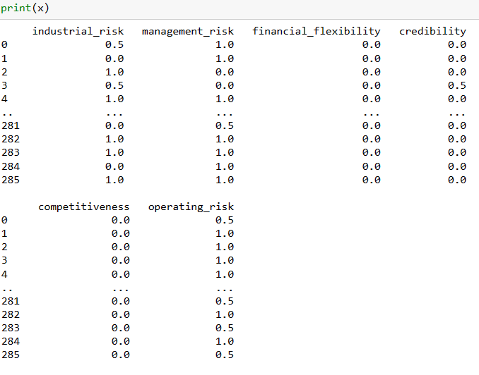
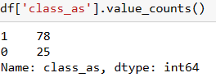
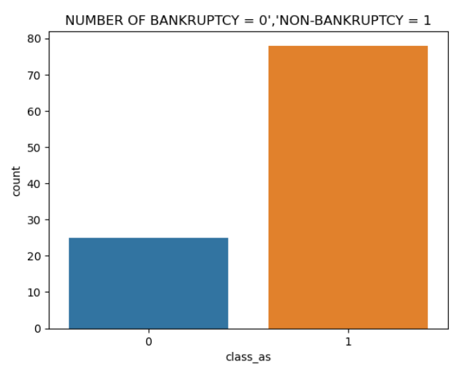
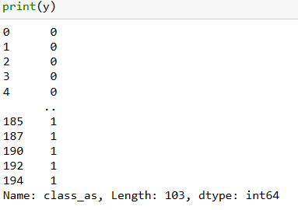
Bankruptcy Prevention Project
SPLITING DATA INTO X & Y
CHECKING FOR DUPLICATRES
>> In the enter data set we have 147 duplicated so,
>> We are going to drop those duplicates after dropping
we can see hear
>> class_as:- bankruptcy = 0 ,non-bankruptcy = 1

Slide 17
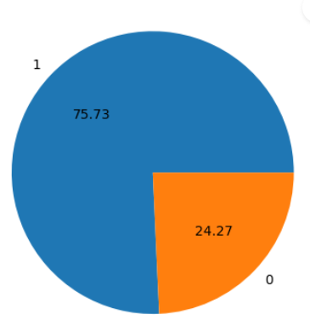
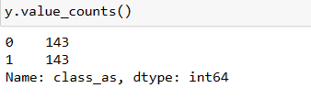
Bankruptcy Prevention Project
PIE PLOT AFTER DROPING DUPLICATES
DATA IS IMBALANCE
DATA BALANCING
By using OVER SAMPLING technique we are going to balance the data
The over sampling is used because the class variable is not evenly distributed with in the balance of ZERO & ONE
NOW THE DATA IS BALANCED

Slide 18
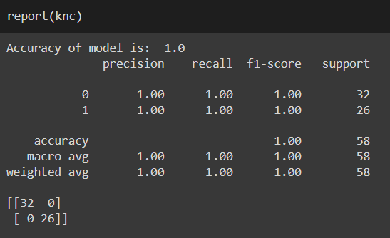
Bankruptcy Prevention Project
Data Splitting : train data = 80% and test data = 20%
MODEL BUILDING:- K-NEAREST NEIGHBOR
K-Nearest Neighbour is one of the simplest Machine Learning algorithms based on Supervised Learning technique.
K-NN algorithm can be used for Regression as well as for Classification but mostly it is used for the Classification problems.
K-NN is a non-parametric algorithm, which means it does not make any assumption on underlying data.
It is also called a lazy learner algorithm because it does not learn from the training set immediately instead it stores the dataset and at the time of classification, it performs an action on the dataset.
KNN : nearest neighbours k=3
This algorithm works by assuming the similarities between
the new data point and available data points.
Based on these similarities, the new data points are put in the most similar categories.

Slide 19


LINEAR-SVC
Bankruptcy Prevention Project
MODEL BUILDING:- SUPPORT VECTOR MACHINE
Support Vector Machine (SVC) is a supervised learning machine learning algorithm.
Support Vector Machine (SVC) algorithm can be used for Regression as well as for Classification but mostly it is used for the Classification problems.
Goal of SVM is to find out the optimal hyperplane/decision boundary in N dimensional space that classify data set
POLYNOMINAL-SVC

Slide 20



Bankruptcy Prevention Project
MODEL BUILDING:- NAIVE BAYES
Naive Bayes algorithm is a supervised learning algorithm.
which is based on Bayes theorem and used for solving classification problems.
Naive Bayes Classifier is one of the simple and most effective Classification algorithms which helps in building the fast machine learning models that can make quick predictions.
It is a probabilistic classifier, which means it predicts on the basis of the probability of an object
GAUSSIAN NAIVE BAYES
MULTINOMIAL NAIVE BAYES
BERNOULLI NAIVE BAYES

Slide 21


Bankruptcy Prevention Project
MODEL BUILDING:- DECISION TREE
Decision Tree algorithm belongs to the family of supervised learning algorithms.
The decision tree algorithm can be used for solving regression and classification problems
The goal of using a Decision Tree is to create a training model that can use to predict the class or value of the target variable by learning simple decision rules inferred from prior data(training data).
Information Gain : Information gain is the measurement of changes in entropy after the segmentation of a dataset
Entropy is a metric to measure the impurity in a given attribute.
DECISION TREE

Slide 22


Bankruptcy Prevention Project
MODEL BUILDING:- LOGISTIC REGRESSION
LR is one of the most popular Machine Learning algorithms, which comes under the Supervised Learning technique.
It is used for predicting the categorical dependent variable using a given set of independent variables.
In LR, instead of fitting a regression line, we fit an "S" shaped logistic function, and the curve lies between 0 and 1
The S-shaped curve is also known as a logistic function that uses the concept of the threshold/cut-off.
Any value above the threshold will tend to 1, and below the threshold will tend to 0.
LOGISTIC REGRESSION

Slide 23

Bankruptcy Prevention Project
MODEL BUILDING:- RANDOM FOREST
Random Forest is a popular machine learning algorithm that belongs to the supervised learning technique.
It can be used for both Classification and Regression problems in ML.
It is based on the concept of ensemble learning, which is a process of combining multiple classifiers to solve a complex problem and to improve the performance of the model
The greater number of trees in the forest leads to higher accuracy and prevents the problem of overfitting.
RANDOM FOREST
RandomForestClassifier(n_estimators=50,
random_state=2)
n_estimators: The maximum number of
estimators (models) to train sequentially.

Slide 24



Bankruptcy Prevention Project
MODEL BUILDING:- ADABOOSTCLASSIFIER ,GRADIENTBOOSTING & XGBOOST
Boosting algorithms combine multiple low accuracy(or weak) models to create a high accuracy(or strong) models.
Boosting algorithms such as AdaBoost, Gradient Boosting, and XGBoost are widely used machine learning algorithm to win the data science competitions.
n_estimators: The maximum number of estimators (models) to train sequentially.
We used n_estimators = 50 , random_state = 2
ADABOOSTCLASSIFIER
GRADIENTBOOSTING
XGBOOST

Slide 25
Bankruptcy Prevention Project
ALL THE MODEL BUILDING ACCURACYE SCORES :-
MECHINE LEARNING ALOGRITHM |  | ACCURACY SCORES
1) K-NEAREST NEIGHBORS |  | 1.0
2) SUPPORT VECTOR MACHINE | LINEAR | 1.0
 | POLYNOMAL | 0.98
3) NAÏVE BAYES | GAUSSIAN | 1.0
 | MULTINOMIAL | 1.0
 | BERNOLLIS | 1.0
4) RANDOM FOREST | n_estimators=50, random_state=2 | 1.0
5) DECISION TREE | ENTROPY | 0.98
6) LOGISTIC REGRESSION |  | 1.0
7) ADABOOSTCLASSIFIER | n_estimators=50, random_state=2 | 0.98
8) GRADIENTBOOSTINGCLASSIFIER | n_estimators=50, random_state=2 | 0.98
9) XGBOOSTCLASSIFIER | n_estimators=50, random_state=2 | 0.98

Slide 26


Bankruptcy Prevention Project
DEPLOMENT :-
NOTE : From all the models we are getting 0.98% for the following models
Svc clf_poly, DecisionTreeClassifier, AdaBoostClassifier, GradientBoostingClassifier, XGBClassifier
For the deployment part I used streamlit service from LOCAL TUNNEL from google colab
If i run the above code it will appear a link, if I click on the link it will directly will take to streamlit service

Slide 27



Bankruptcy Prevention Project
DEPLOMENT :-

Slide 28


Bankruptcy Prevention Project
DEPLOMENT :-

Slide 29


Bankruptcy Prevention Project
DEPLOMENT :-
PREDICTING AS ZERO THAT MEANS BANKRUPTCY

Slide 30

Bankruptcy Prevention Project
DEPLOMENT :-
PREDICTING AS ONE THAT MEANS NON- BANKRUPTCY

Slide 31
Bankruptcy Prevention Project
PROBLEMS WE FACED IN THIS PROJECT
The problem with a model trained on imbalanced data is that the model learns that it can achieve high accuracy by consistently predicting the majority class, even if recognizing the minority class is of equal or more importance when applying the model to a real-world scenario.
Balancing a dataset makes training a model easier because it helps prevent the model from becoming biased towards one class.
Data is imbalance, so we have to balance the data to improve higher accuracy models, higher balanced accuracy and balanced detection rate for a classification model.
We have different techniques and we used oversampling technique to balance data
During model building we have used different models but some models are overfitted on our data so we choose the following models
Svc clf_poly, DecisionTreeClassifier, AdaBoostClassifier, GradientBoostingClassifier, XGBClassifier. Model for
deployment because it gives high accuracy and better prediction.
Workflows that can't move between cloud and on-prem infrastructure that we have deployed

Slide 32
Bankruptcy Prevention Project
FOR ANY QUERIES
NAMES | MAIL.ID | CONTACT.NO
KAKARAPARTHI MAHESH | kakaraparthimahesh98@gmail.com | 9398467644
Mrs. DIPALI VINAY PATIL | patildipali310@gmail.com | 8657704180
MISS. TEJASWINI ASHOKRAO AHER | tejaswiniaher2501@gmail.com | 7038444708
Ms .UJWALA SANJAY PAWAR | peehupawar45@gmail.com | 7039593081
Mr. SHUBHAM BALASAHEB BHOSALE | shubhambhosale.sb8055@gmail.com | 8149805009
Ms. Avanti Laxman Avhad | avantiavhad63@gmail.com | 7558418301
Mr. ANIL PARABATI JADHAV | anilj354@gmail.com | 9867618665

Slide 33

Bankruptcy Prevention Project

